Slide 1
Chemical Bonding I: Basic Concepts
Chapter 9
Dr. Sultana Bedoura

Slide 2
Introduction
Chemical Bond
A chemical bond is defined as a force that acts
between two or more atoms to hold them together
as a stable molecule
Major kinds of chemical bond
Ionic bond
Covalent bond
Coordinate covalent bond

Slide 3
Lecture Plan
Lewis Dot Symbol
Ionic Bond
Lattice energy
Covalent bond
Co-ordinate covalent bond
Polar covalent bond
Hydrogen bond
Electronegativity

Slide 4
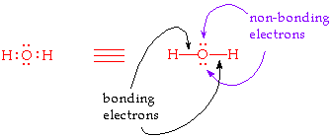
Valence Electrons
Valence electron(VE)
Outer shell electrons of an atom
VE s are primary concern during chemical bonding
As VE participates in chemical bonding
Presence of VEs determine chemical property of elements
Bonding and non-bonding electron
VEs involved in bond formation are called bonding electrons
The remaining VEs still available for bond formation are referred to as non-bonding electrons

Slide 5
Valence Electrons
Group
e⁻ configuration
# of valence e⁻
1A
ns¹
1
2A
ns²
2
3A
ns²np¹
3
4A
ns²np²
4
5A
ns²np³
5
6A
ns²np⁴
6
7A
ns²np⁵
7

Slide 6
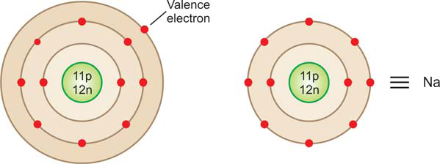
Lewis Dot Symbols
A Lewis Dot Symbol is consist of the symbol of the element and one dot for each VE in an atom
In this notation, the symbol of an element represents the nucleus plus the inner normally filled levels (or shells) of the atom

Slide 7

Lewis Dot Symbols
How to represent a Lewis symbol for an element
Write down the symbol of the element and surround the symbol with a number of dots (or crosses) equal to the number of VEs
The position of dots around the symbol is not really of any significance
The bonding electrons are shown at appropriate positions, while the rest of the electrons are generally given in pairs

Slide 8
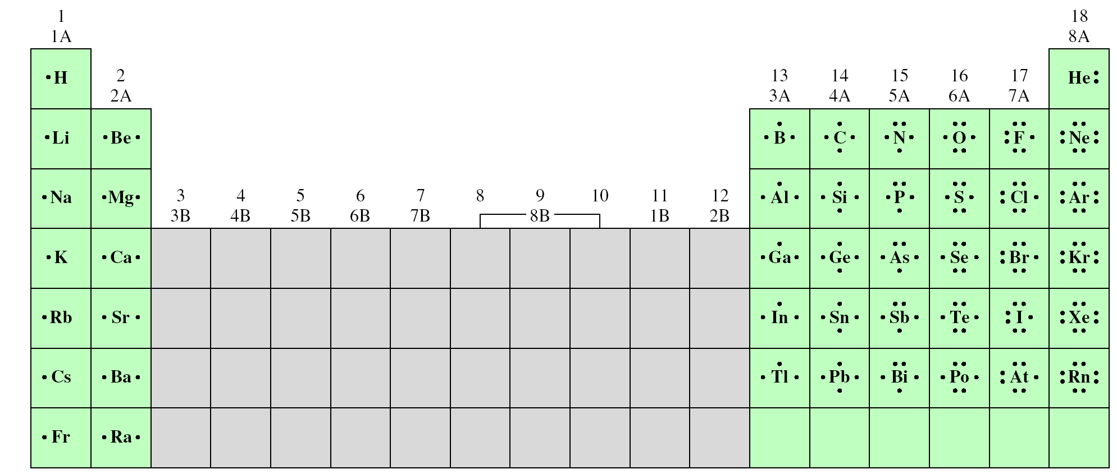
Lewis Dot Symbols
Lewis dot symbols for the representative elements and the noble gases
The number of unpaired dots corresponds to the number of bonds an atom of the element can form in a compound

Slide 9
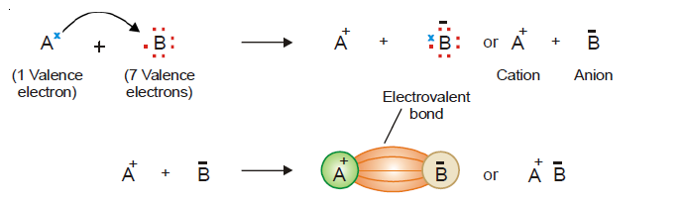
The Ionic Bond
The electrostatic force that holds ions together in an ionic compound
The electrostatic attraction between the cation (+) and anion (–) produced by electron-transfer constitutes an Ionic bond
Cation | Anion
Low ionization energy | High e- affinity
Na⁺, Ca²⁺ | Cl⁻, O²⁻

Slide 10
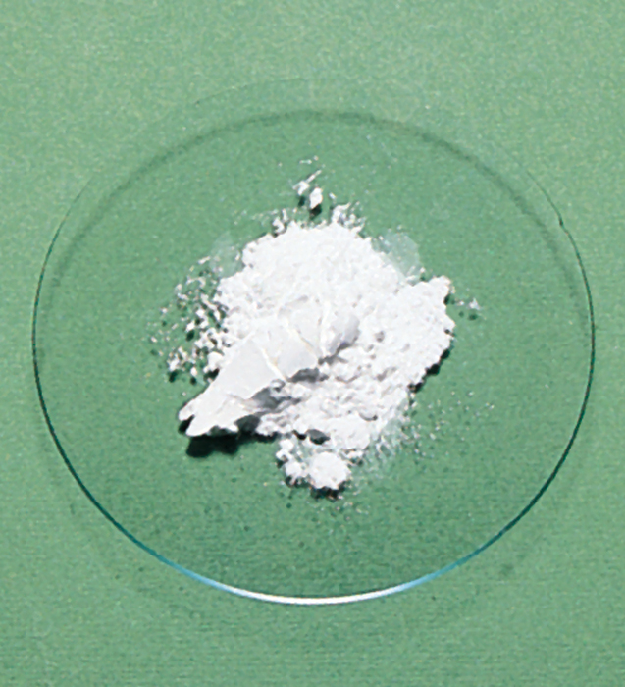
The Ionic Bond
LiF: An ionic compound
Li
+
F
Li⁺
-
F
1s²2s¹
1s²2s²2p⁵
[He]
1s²
1s²2s²2p⁶
[Ne]
Li
Li⁺ + e⁻
LiF
e⁻ +
-
F
F
-
-
Li⁺ +
F
Li⁺
F

Slide 11
Electrostatic (Lattice) Energy
Lattice energy (U): the energy required to completely separate one mole of a solid ionic compound into gaseous ions
Q₊Q₋
Compound
Lattice Energy
(kJ/mol)
E = k
r
E is the potential energy
MgF₂
2957
Q: +2,-1
Q₊ is the charge on the cation
MgO
3938
Q: +2,-2
Q₋ is the charge on the anion
LiF
1036
r is the distance between the ions
r F⁻ < r Cl⁻
LiCl
853
Lattice energy increases
as Q increases and/or as r decreases

Slide 12
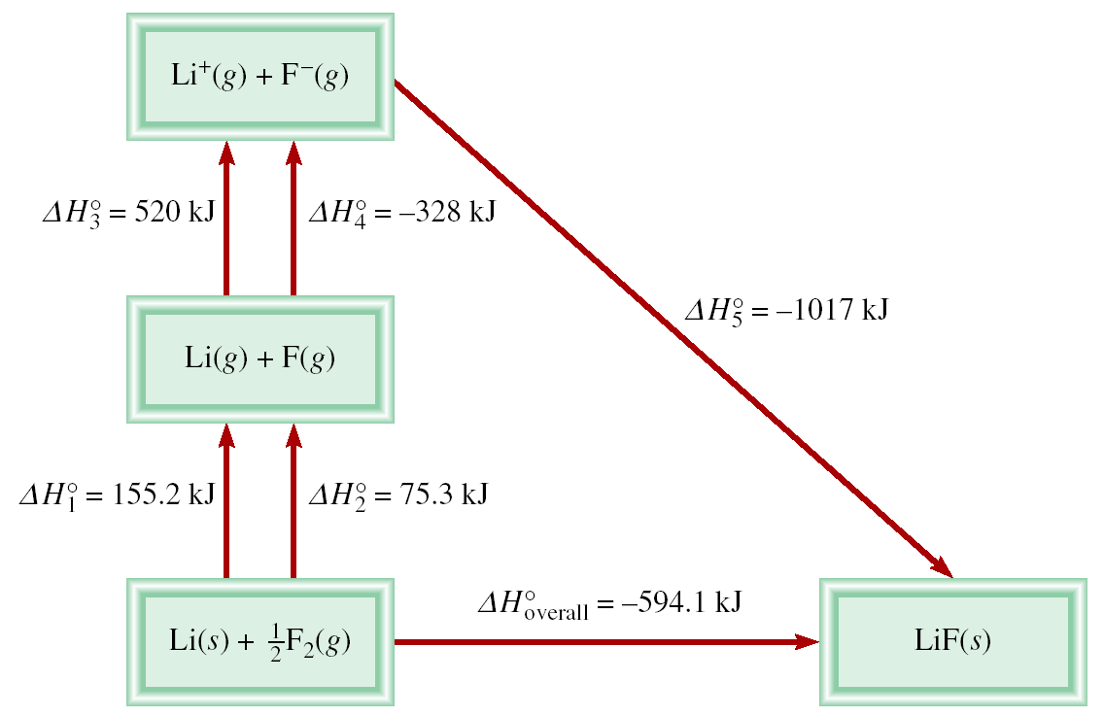
Born-Haber Cycle
Born-Haber Cycle for Determining Lattice Energy
o
o
o
o
o
o
ΔH_{overall} = ΔH₁ + ΔH₂ + ΔH₃ + ΔH₄ + ΔH₅

Slide 13
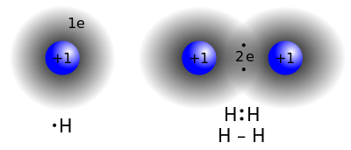
Covalent Bond
Covalent bond: a chemical bond in which two or more electrons are shared by two atoms
Lewis structure of F₂
F
+
F
F
F
7e⁻
7e⁻
8e⁻
8e⁻
single covalent bond
single covalent bond
lone pairs
F
F
lone pairs
F
F
lone pairs

Slide 14
Examples of Covalent Bond
Single bond: two atoms share one pairs of electrons
Double bond: two atoms share two pairs of electrons
Triple bond: two atoms share three pairs of electrons
H
+
O
+
H
H
O
H
or
H
O
H
2e⁻
8e⁻
2e⁻
single covalent bonds
O
C
O
or
O
C
O
8e⁻
8e⁻
8e⁻
double bonds
double bonds
N
N
or
N
N
8e⁻
8e⁻
triple bond
triple bond

Slide 15
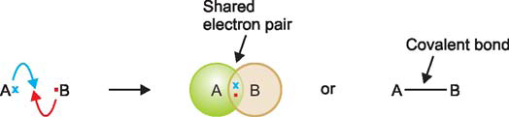
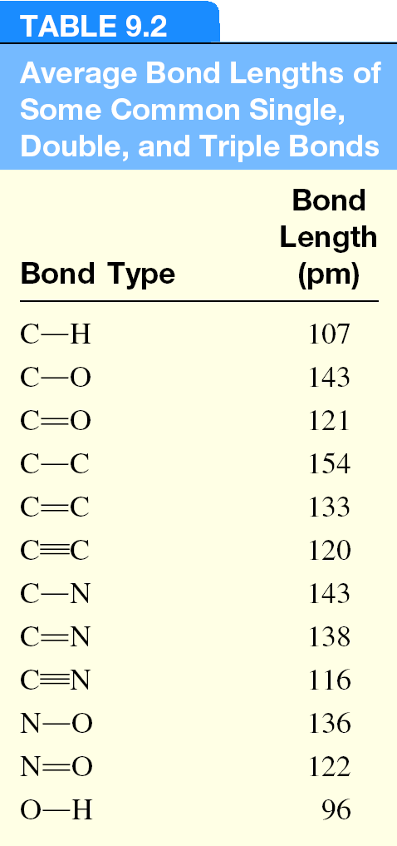
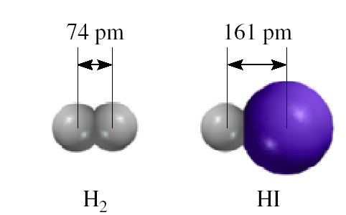
Lengths of Covalent Bond
Average Bond Lengths of single, double and triple bonds
Bond Lengths
Triple bond < Double Bond < Single Bond

Slide 16
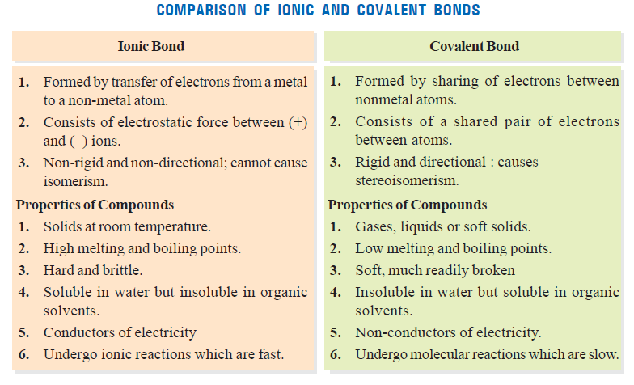
Comparison
Comparison of ionic and covalent bonds

Slide 17
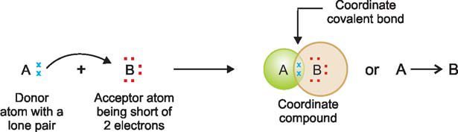
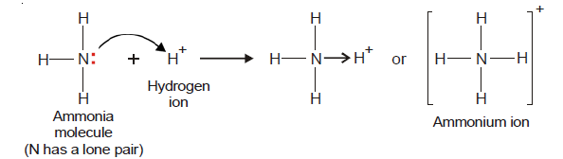
CO-ORDINATE COVALENT BOND
Co-ordinate covalent bond
A covalent bond in which both electrons of the shared pair come from one of the two atoms (or ions)
Ammonium ion, NH4⁺

Slide 18
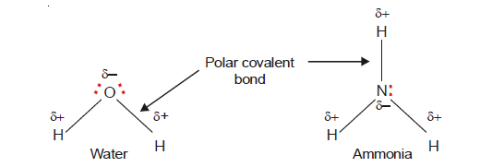
Polar Covalent bond
Polar covalent bond
A covalent bond with greater electron density around one of the two atoms
Due to unequally shared electrons, the bonded atoms acquire a partial positive and negative charge
The greater the difference of electronegativity between two atoms, greater the polarity

Slide 19
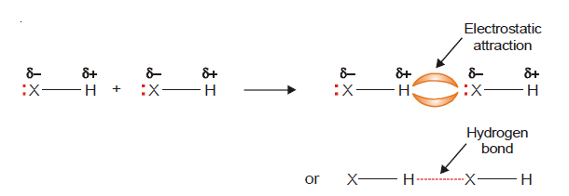
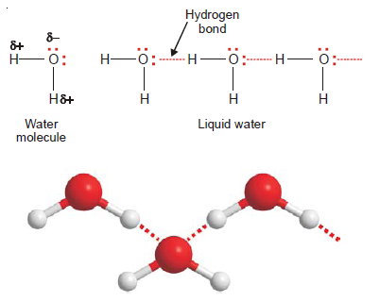
HYDROGEN BONDING
H-bonding:
When hydrogen (H) is covalently bonded to a highly electronegative atom X (O, N, F)of another molecule, the shared electron pair is pulled so close to X that a strong dipole results
Example: H₂O

Slide 20
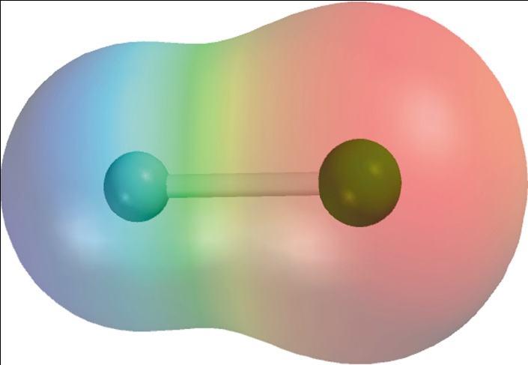
Electronegativity
Electronegativity
The ability of an atom to attract toward itself the electrons in a chemical bond
Electron Affinity - measurable, Cl is highest
X _{(g)} + e⁻ X⁻_{(g)}
Electronegativity - relative, F is highest
electron poor region
e⁻ poor
e⁻ rich
H
F
H
F
δ⁺
δ⁻
electron rich region

Slide 21

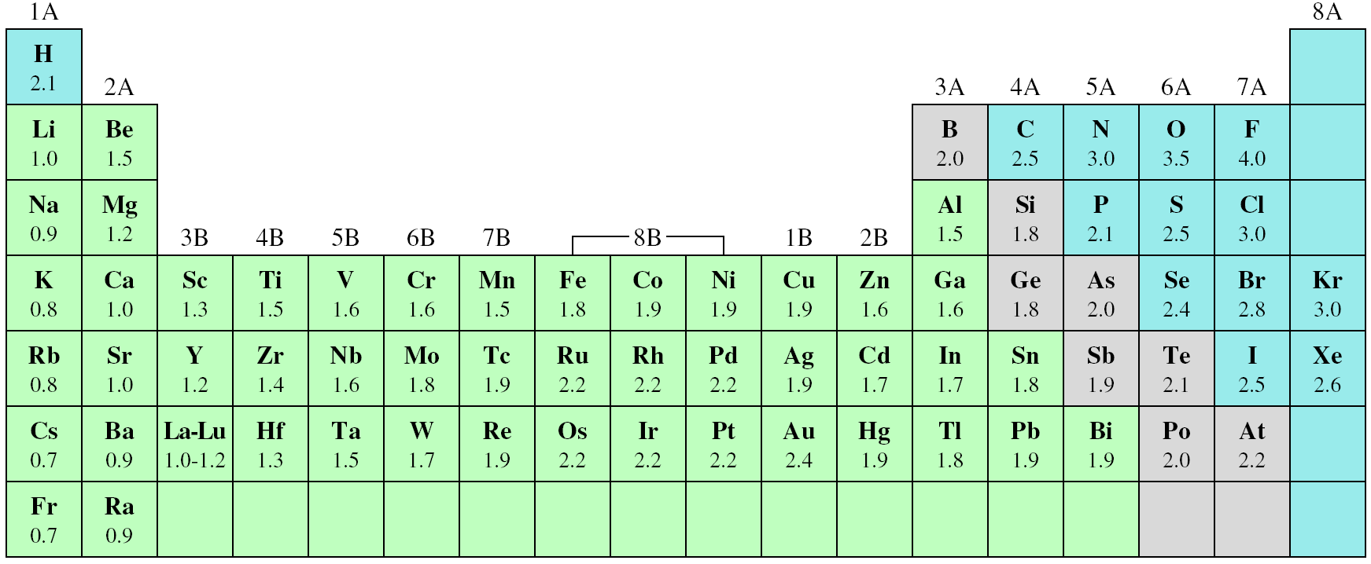
Electronegativity of Elements

Slide 22
Classification of Bonds
Difference Bond Type Example
Increasing difference in Electronegativity
0
Covalent
H₂, F₂
≥ 2
Ionic
NaCl
0 < and <2
Polar Covalent
H₂O
Covalent
Polar Covalent
Ionic
share e⁻
partial transfer of e⁻
transfer e⁻

Slide 23
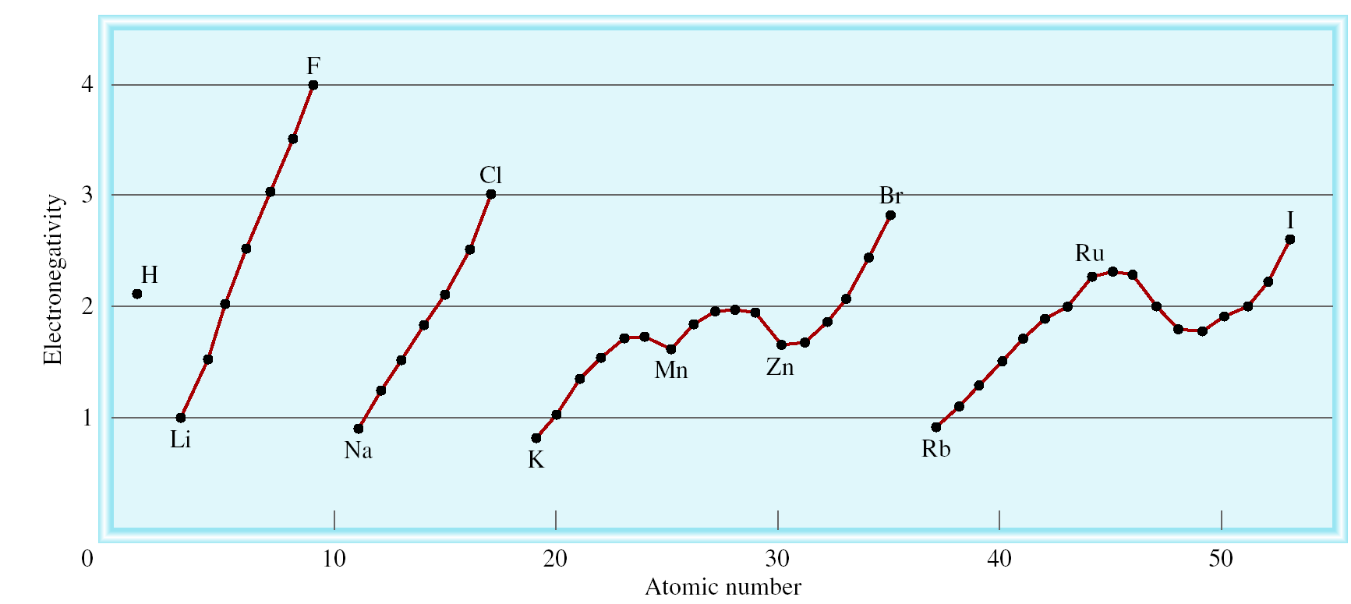
Electronegativity vs Atomic Number

Slide 24
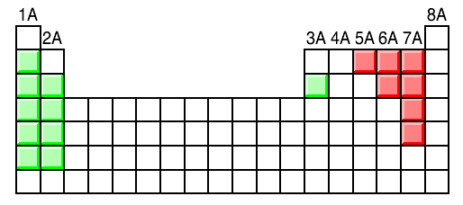
Classification of Bonds
Classify the following bonds as ionic, polar covalent, or covalent: The bond in CsCl; the bond in H₂S; and the NN bond in H₂NNH₂.
Cs – 0.7
Cl – 3.0
3.0 – 0.7 = 2.3
Ionic
H – 2.1
S – 2.5
2.5 – 2.1 = 0.4
Polar Covalent
N – 3.0
N – 3.0
3.0 – 3.0 = 0
Covalent

Slide 25
Writing Lewis Structures
Draw skeletal structure of compound showing what atoms are bonded to each other. Put least electronegative element in the centre.
Count total number of VE. Add 1 for each negative charge. Subtract 1 for each positive charge.
Complete an octet for all atoms except hydrogen.
If structure contains too many electrons, form double and triple bonds on central atom as needed

Slide 26
Lewis Structures
Write the Lewis structure of nitrogen trifluoride (NF₃).
Step 1 – N is less electronegative than F, put N in center
Step 2 – Count VE. N: 5(2s²2p³) and F: 7(2s²2p⁵)
5 + (3 x 7) = 26 VE
Step 3 – Draw single bonds between N and F atoms and
complete octets on N and F atoms.
Step 4 – Check.Are no of e⁻ in structure equal to number of VE?
3 single bonds (3x2) + 10 lone pairs (10x2) = 26 VE
F
N
F
F

Slide 27


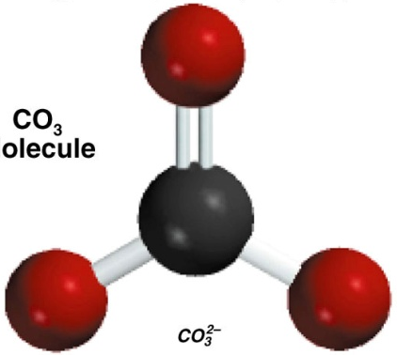
Lewis Structures
Write the Lewis structure of the carbonate ion (CO₃²⁻).
Step 1 – N is less electronegative than F, put N in center
Step 2 – Count VE. C: 4(2s²2p²); O: 6(2s²2p⁴) ; -2 charge→2e⁻
4 + (3 x 6) + 2 = 24 VE
Step 3 – Draw single bonds between C and O atoms and
complete octet on C and O atoms
Step 4 – Check.Are no of e⁻ in structure equal to number of VE?
3O atom (3X6), 1O atom (4) and -2 charges = 24 VE

Slide 28
Formal charge
Formal charge : The difference between the number of VEs in an isolated atom and the number of electrons assigned to that atom in a Lewis structure
Example:
Two possible skeletal structures of formaldehyde (CH₂O)
formal charge on an atom in a Lewis structure
total number of valence electrons in the free atom
total number of nonbonding electrons
1
(
total number of bonding electrons
)
=
-
-
2
H
H
C
O
H
C
O
H
The sum of the formal charges of the atoms in a molecule or ion must equal the charge on the molecule or ion

Slide 29
Formal charge on ch₂o
formal charge on an atom in a Lewis structure
total number of valence electrons in the free atom
total number of nonbonding electrons
1
(
total number of bonding electrons
)
=
-
-
2
C – 4 e⁻
0
0
C – 4 e⁻
-1
+1
H
O – 6 e⁻
C
O
O – 6 e⁻
H
C
O
H
2H – 2x1 e⁻
H
2H – 2x1 e⁻
12 e⁻
12 e⁻
2 single bonds (2x2) = 4
2 single bonds (2x2) = 4
1 double bond = 4
1 double bond = 4
2 lone pairs (2x2) = 4
2 lone pairs (2x2) = 4
Total = 12
Total = 12
formal charge on C = 4-2- ½ x 6 = -1
formal charge on C = 4-0- ½ x 8= 0
formal charge on O = 6-4- ½ x 4= 0
formal charge on O = 6-2- ½ x 6 = +1

Slide 30
Formal Charge and Lewis Structures
For neutral molecules, a Lewis structure in which there are no formal charges is preferable to one in which formal charges are present.
Lewis structures with large formal charges are less plausible than those with small formal charges.
Among Lewis structures having similar distributions of formal charges, the most plausible structure is the one in which negative formal charges are placed on the more electronegative atoms.
Which is the most likely Lewis structure for CH₂O?
-1
+1
0
0
H
H
C
O
H
C
O
H

Slide 31
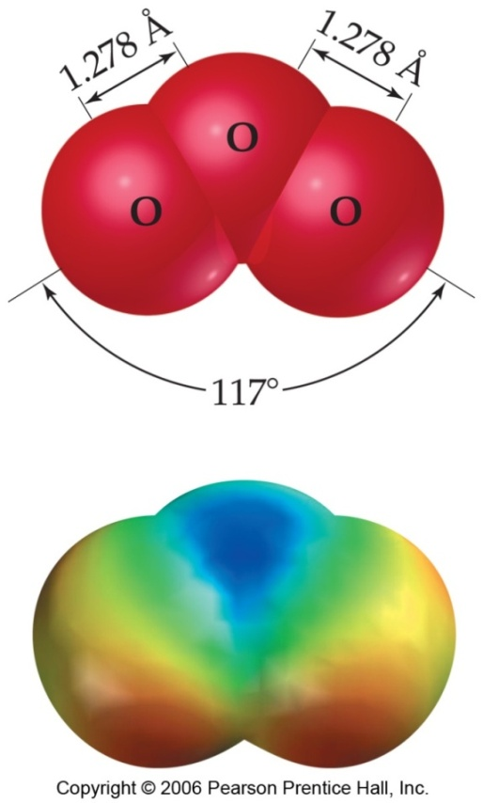
Resonance Structures
A resonance structure is one of two or more Lewis structures for a single molecule that cannot be represented accurately by only one Lewis structure
But this is at odds with the true,
observed structure of ozone, in which…
…both O-O bonds are the same length.
…both outer oxygens have a charge of -1/2
+
-
+
-
O
O
O
O
O
O

Slide 32
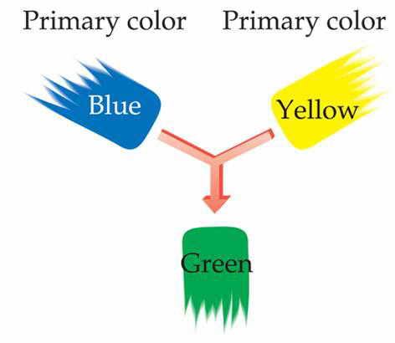
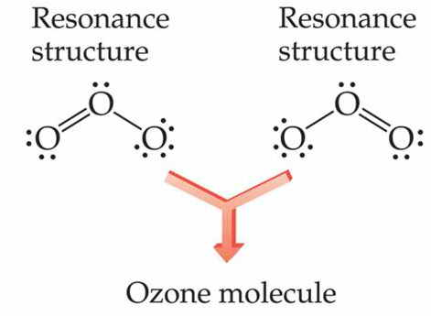
Resonance Structures
What are the resonance structures of the carbonate (CO₃²⁻) ion?
…just as green is a synthesis of blue and yellow…
…ozone is a synthesis of these two resonance structures
-
-
-
-
O
C
O
O
C
O
O
C
O
O
O
O
-
-

Slide 33
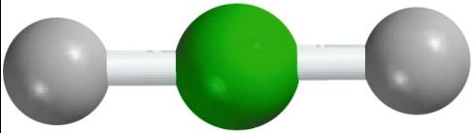
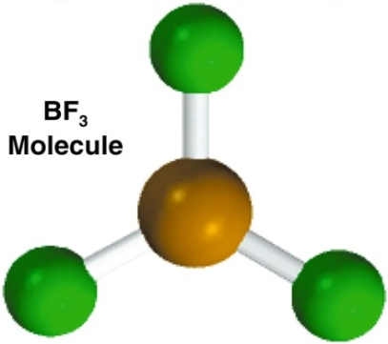
Exceptions to the Octet Rule
The Incomplete Octet
Be – 2e⁻
BeH₂
2H – 2x1e⁻
H
Be
H
4e⁻
B – 3e⁻
F
B
F
BF₃
3F – 3x7e⁻
24e⁻
F
3 single bonds (3x2) = 6
9 lone pairs (9x2) = 18
Total = 24

Slide 34
Exceptions to the Octet Rule
Odd-Electron Molecules
N – 5e⁻
NO
O – 6e⁻
N
O
11e⁻
The Expanded Octet
(central atom with principal quantum number n > 2)
F
F
F
S – 6e⁻
6 single bonds (6x2) = 12
SF₆
6F – 42e⁻
S
18 lone pairs (18x2) = 36
48e⁻
Total = 48
F
F
F

Slide 35
Bond Enthalpy
Bond enthalpy:
The enthalpy change required to break a particular bond in one mole of gaseous molecules
H_{2 (g)}
H _{(g)}
+
H _{(g)}
ΔH⁰ = 436.4 kJ
Cl_{2 (g)}
Cl _{(g)}
ΔH⁰ = 242.7 kJ
+
Cl _{(g)}
HCl _{(g)}
H _{(g)}
+
Cl _{(g)}
ΔH⁰ = 431.9 kJ
O_{2 (g)}
O _{(g)}
+
O _{(g)}
ΔH⁰ = 498.7 kJ
O
O
N_{2 (g)}
N _{(g)}
+
N _{(g)}
ΔH⁰ = 941.4 kJ
N
N
Bond Enthalpies
Single bond < Double bond < Triple bond

Slide 36
Average Bond Enthalpy
Average bond enthapy in polyatomic molecules
H₂O _{(g)}
H _{(g)}
+
OH _{(g)}
ΔH⁰ = 502 kJ
OH _{(g)}
H _{(g)}
+
O _{(g)}
ΔH⁰ = 427 kJ
502 + 427
Average OH bond enthalpy =
2
= 464 kJ

Slide 37
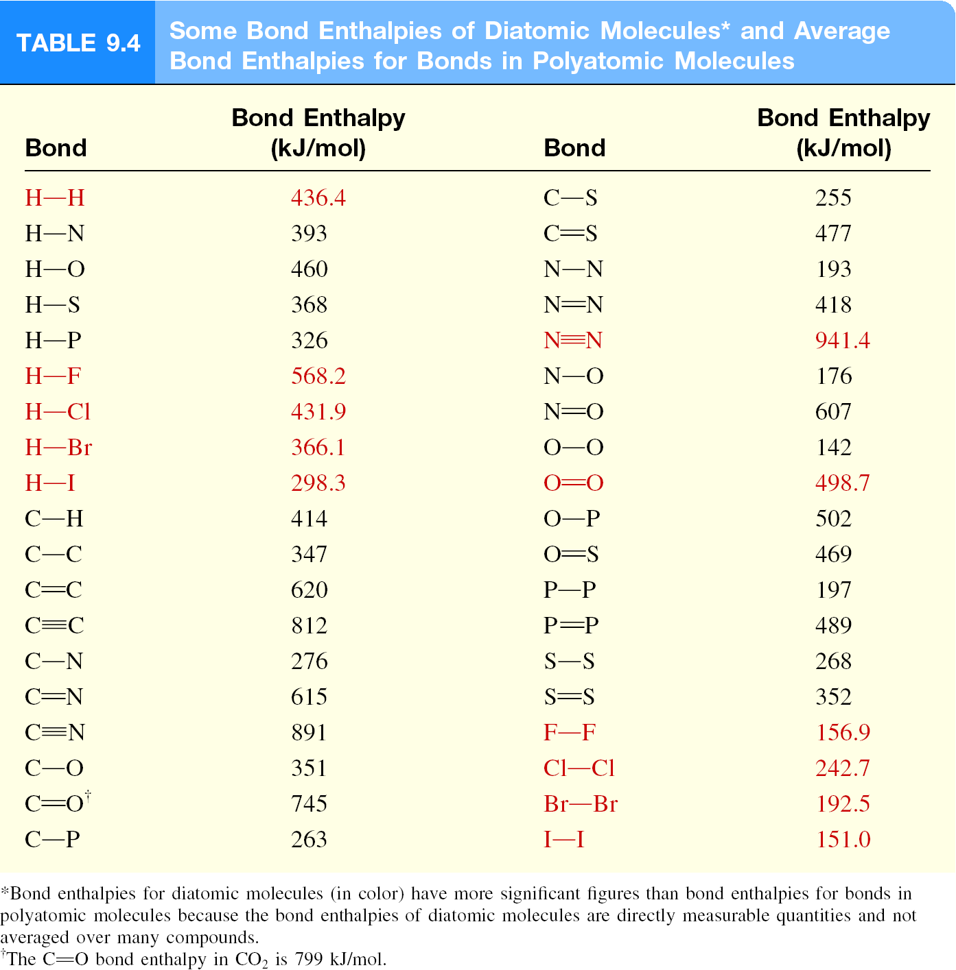
Bond Enthalpy
Bond Enthalpies of Diatomic Molecules* and Average Bond Enthalpies for Bonds in Polyatomic Molecules

Slide 38
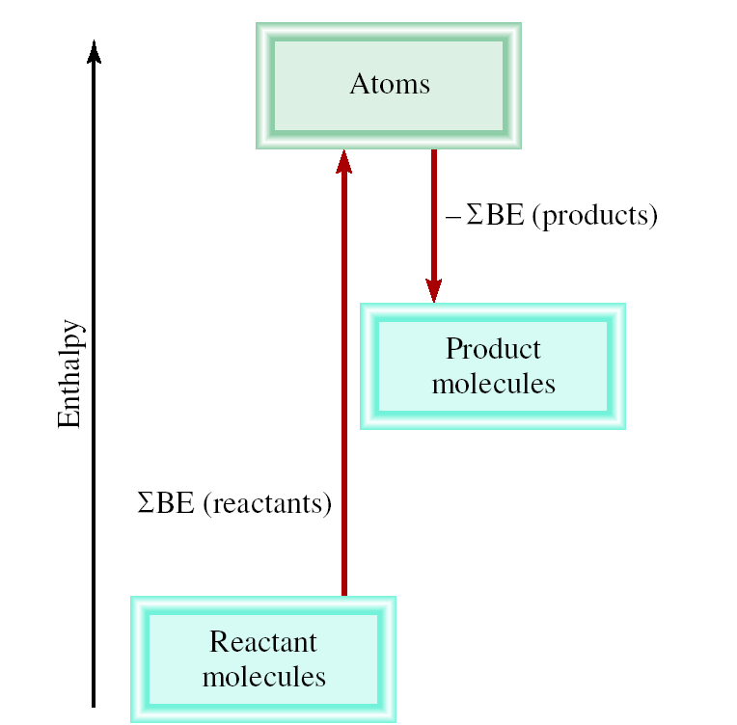
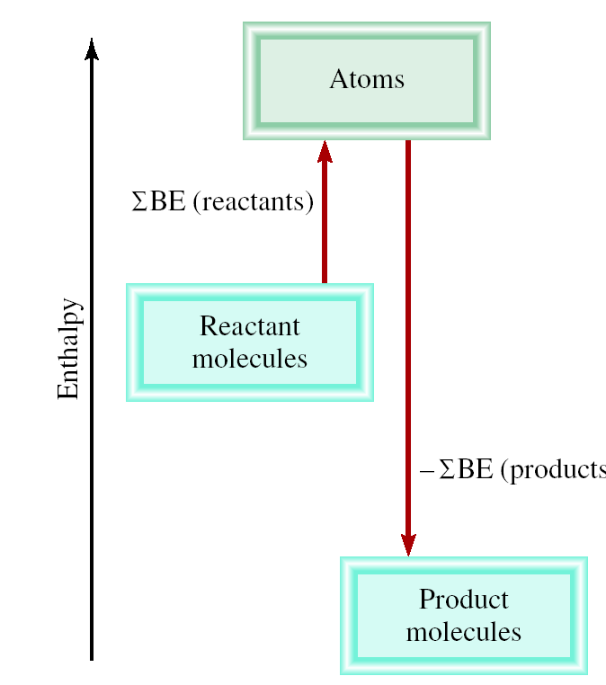
Bond Enthalpies (BE)
Imagine reaction proceeding by breaking all bonds in the reactants and then using the gaseous atoms to form all the bonds in the products
ΔH⁰ = total energy input – total energy released
= ΣBE(reactants) – ΣBE(products)
endothermic
exothermic

Slide 39
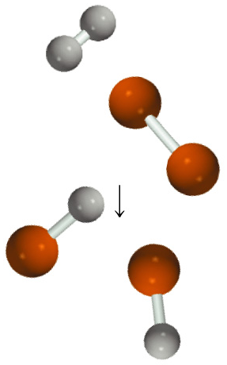
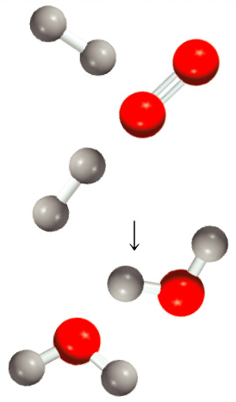
Bond formation
H₂ (g) + Cl₂ (g) 2HCl (g)
2H₂ (g) + O₂ (g) 2H₂O (g)

Slide 40
Bond Enthalpy
Use bond enthalpies to calculate the enthalpy change for:
H_{2 (g)} + F_{2 (g)} 2HF _{(g)}
ΔH⁰ = ΣBE(reactants) – ΣBE(products)
Type of bonds broken
Number of bonds broken
Bond enthalpy (kJ/mol)
Enthalpy change (kJ/mol)
H
H
1
436.4
436.4
F
F
1
156.9
156.9
Type of bonds formed
Number of bonds formed
Bond enthalpy (kJ/mol)
Enthalpy change (kJ/mol)
H
F
2
568.2
1136.4
ΔH⁰ = 436.4 + 156.9 – 2 x 568.2 = -543.1 kJ/mol

Slide 41
Thank you

